Slide 1


Breaking
the Code:
Understanding Tokens and Lexemes
How Compilers Identify the Parts of a Program
S.MAHALAKSHMI
192524372
COMPLIER DESIGN
CSA1410
FACULTY:
Dr.N.Deepa

Slide 2

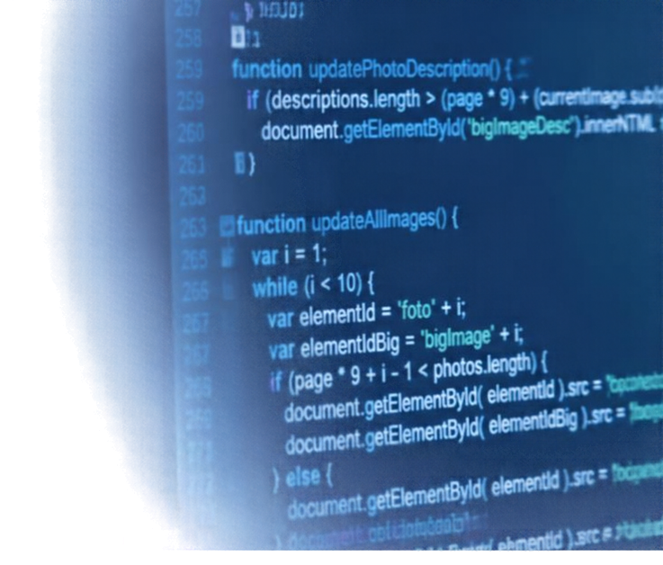






Introduction to Lexical Analysis
The first phase of a compiler that reads source code.
It breaks the source code into smaller,
meaningful parts.
Tokens are categories.
The Lexemes are actual text seen in the code.
SOURCE CODE
LEXICAL ANALYZER
TOKENS
Raw program text
Scans and breaks code
into meaningful parts
Sequence of tokens
for the next phase

Slide 3






What Are Tokens?
int
KEYWORDS
reserved words
age
IDENTIFIERS
names in code
Tokens are the building blocks of a program.
+
OPERATORS
perform actions
100
Each token is a
category or type
of symbol in code.
CONSTANTS
fixed values
;
PUNCTUATION SYMBOLS
separate instructions

Slide 4

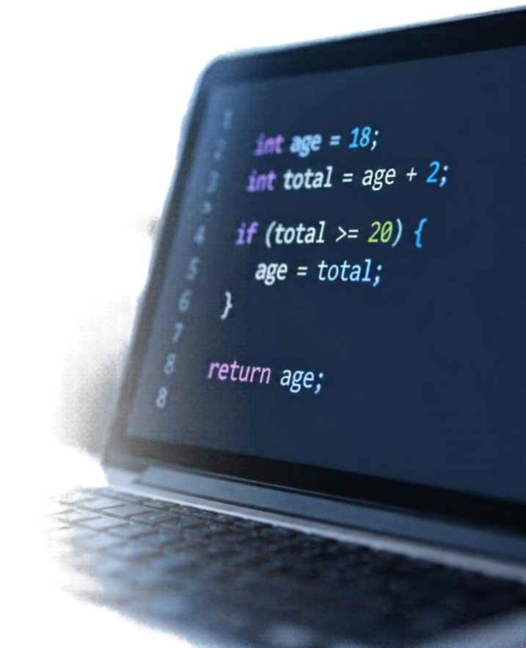





What Are Lexemes?
Lexemes are the actual character sequences written in source code that match a token.
Tokens are the categories we assign to them.
LEXEME
EXAMPLE
TOKEN CATEGORY
int
int
keyword token
age
age
identifier token
18
18
constant token (number)
+
+
operator token

Slide 5
















Practical Example
See how a single line of code breaks down into tokens.
LEXEME
TOKEN TYPE
int
Keyword
int age = 18;
age
Identifier
Assignment operator
Each piece of text is a lexeme.
Integer constant
The compiler groups lexemes into
tokens to understand the code.
;
Punctuation symbol
Tokens guide the parser to check correctness and build program logic.

Slide 6

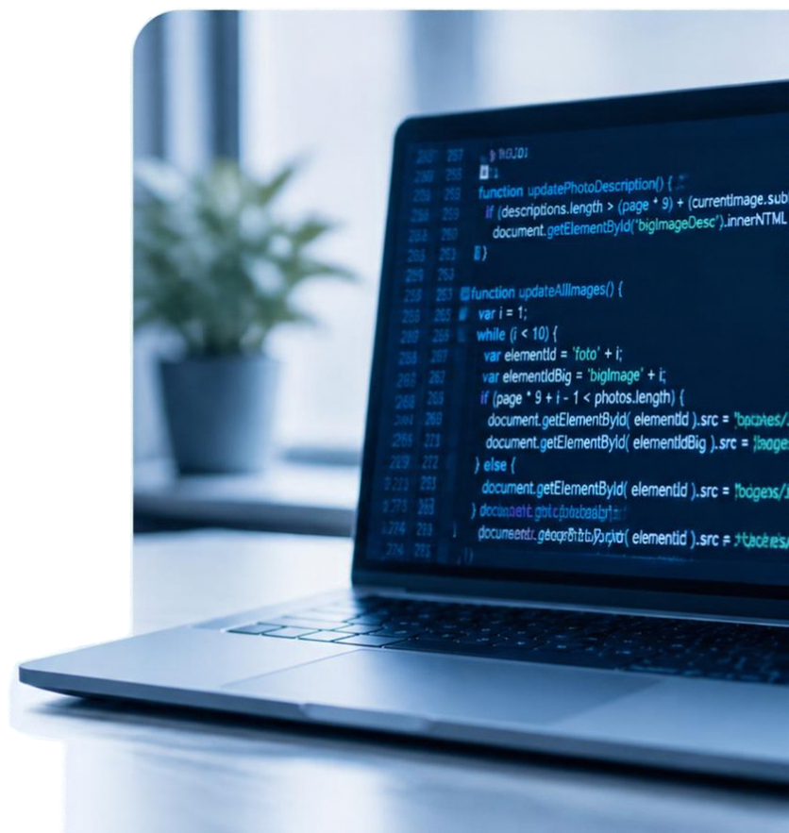
Conclusion
Tokens represent categories of code symbols.
Lexemes are actual text sequences in source code.
Lexical analysis finds lexemes and creates tokens.
Tokens are sent to the parser for syntax analysis.
Thank you for listening!

Slide 7
